Slide 1
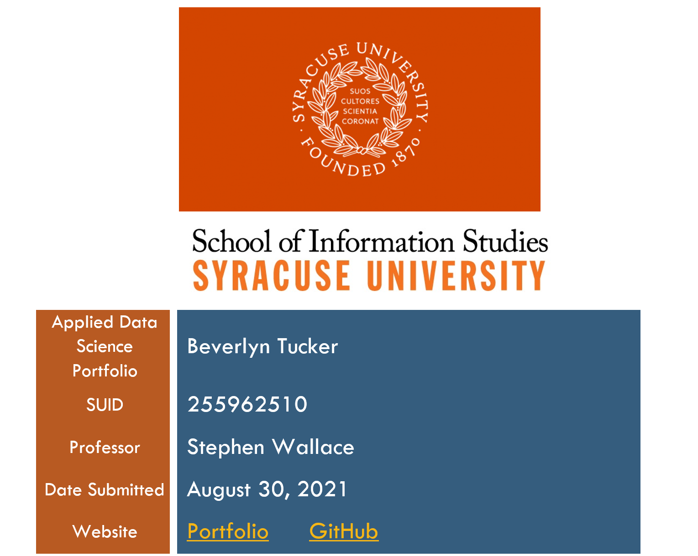

Slide 2
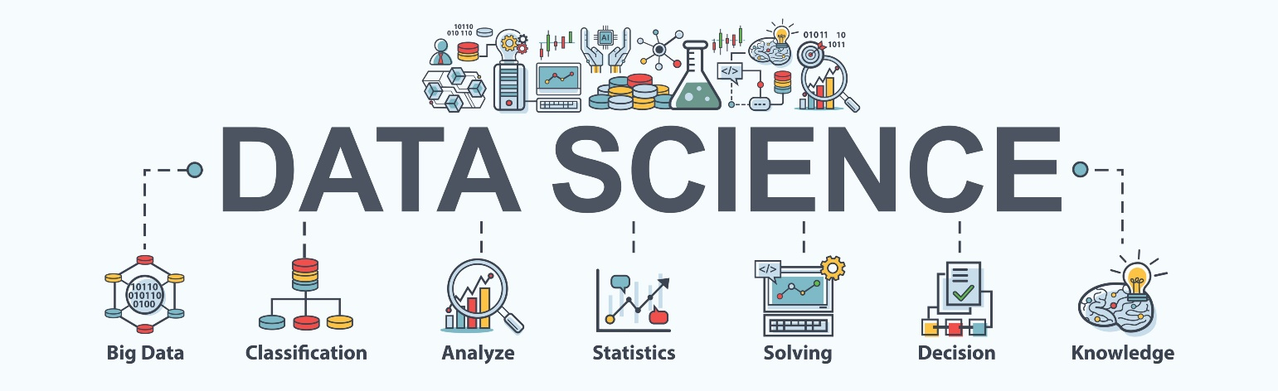
Notes:
Data science components
Data use to drive actionable insights across a broad range of application domains

Slide 3

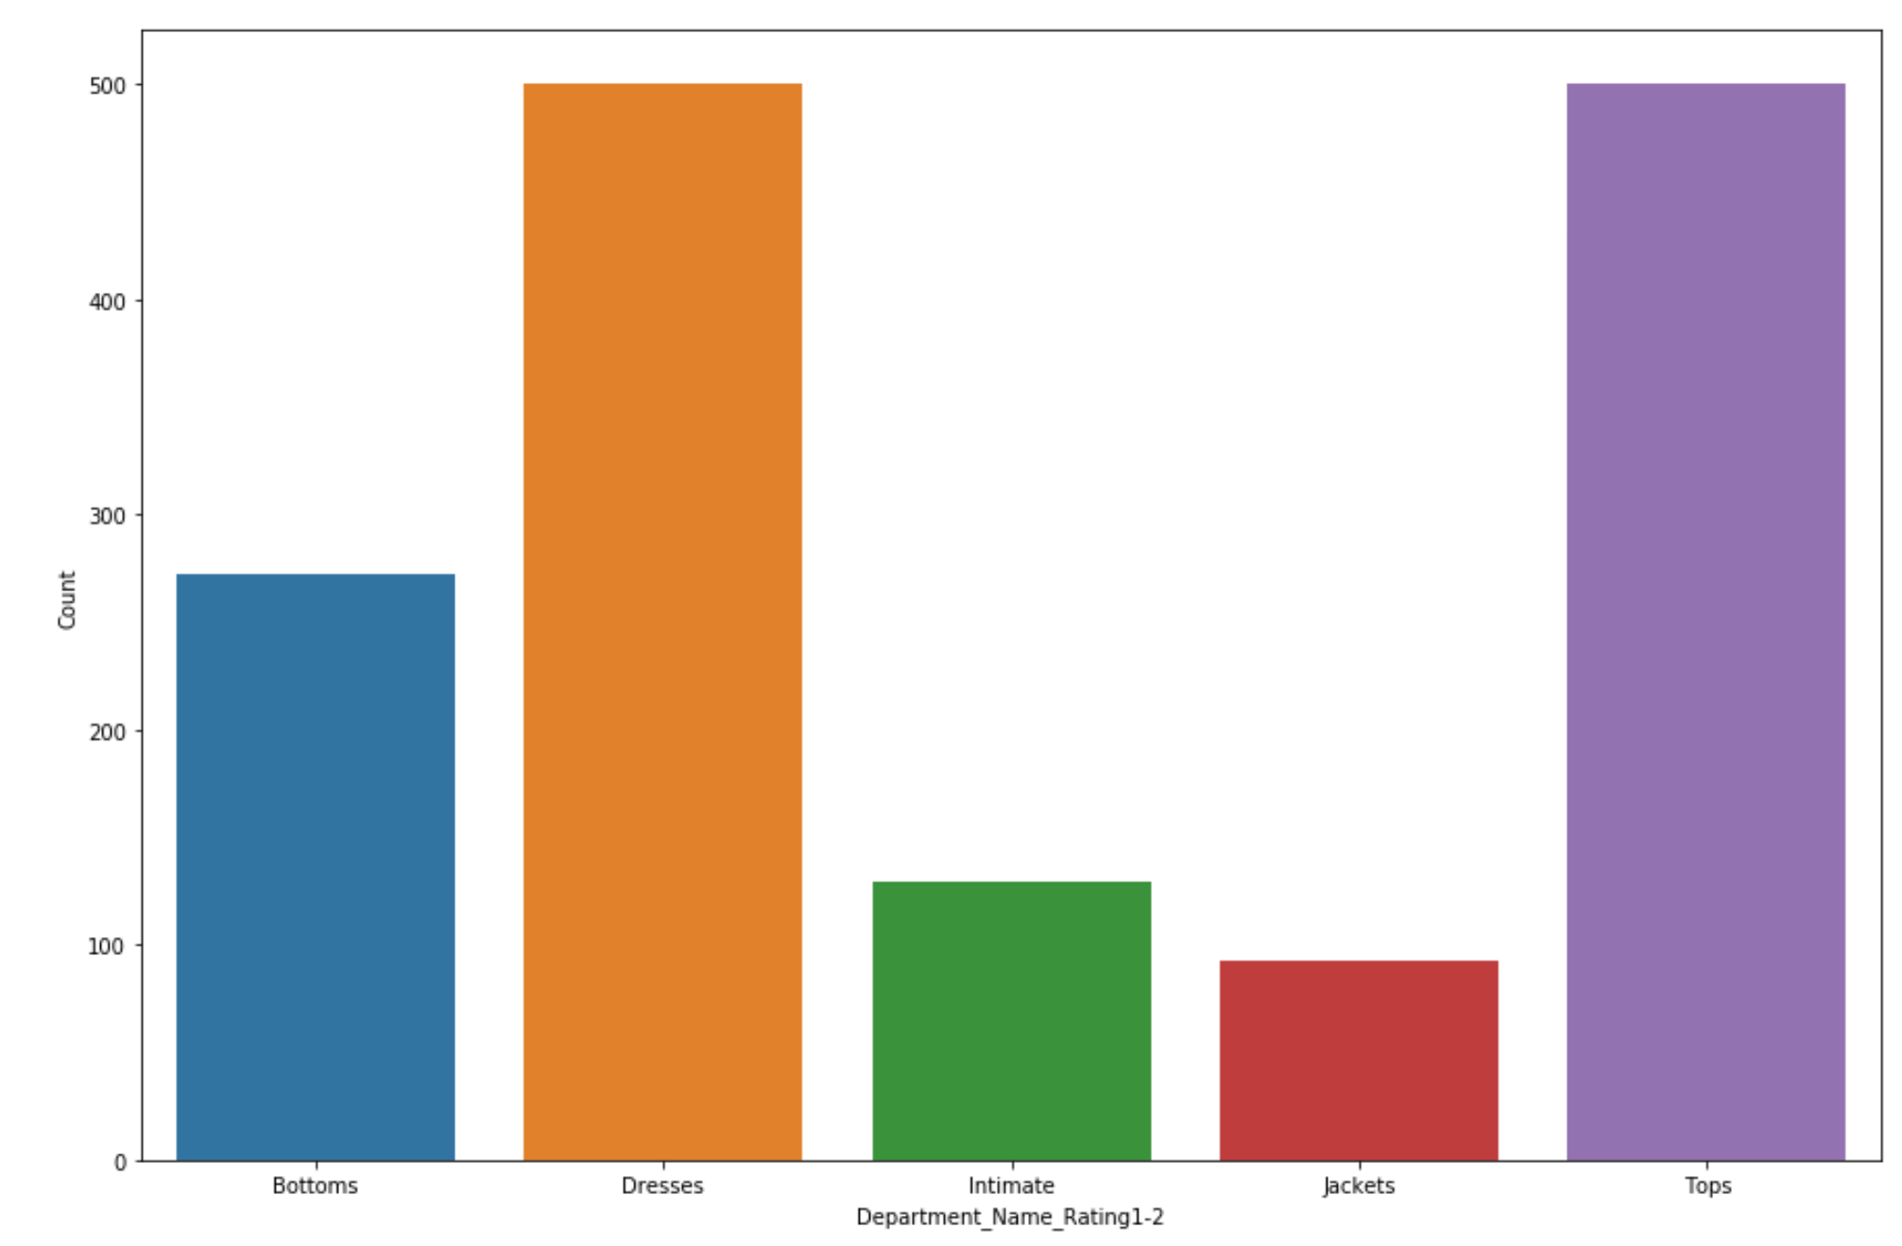
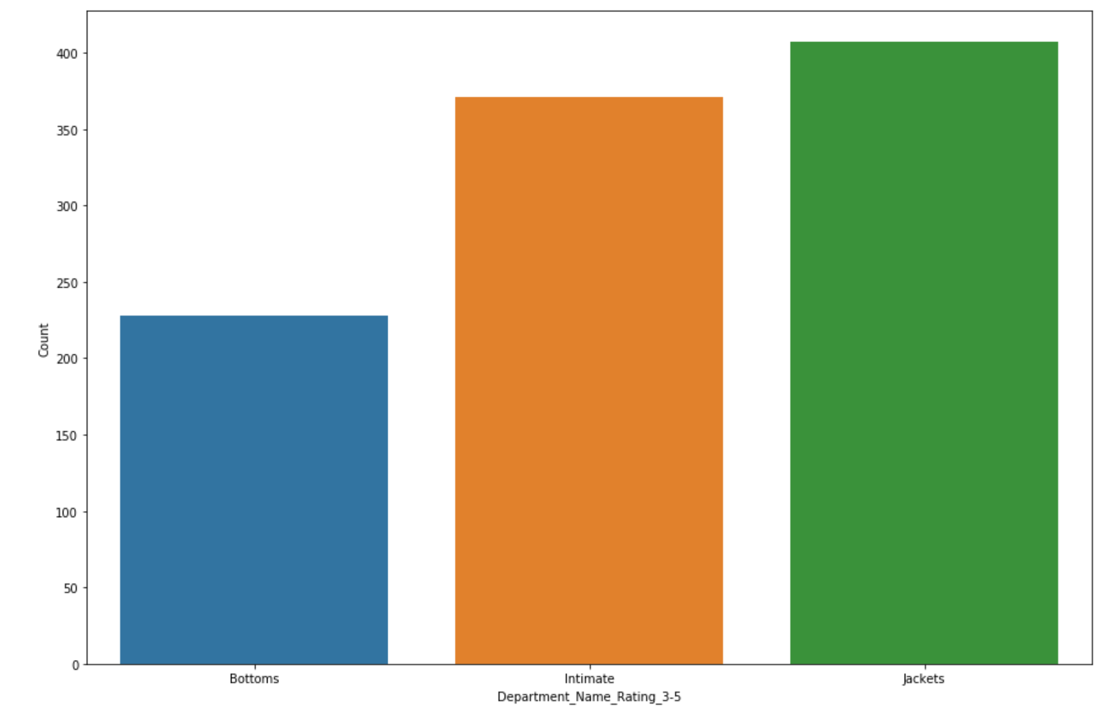
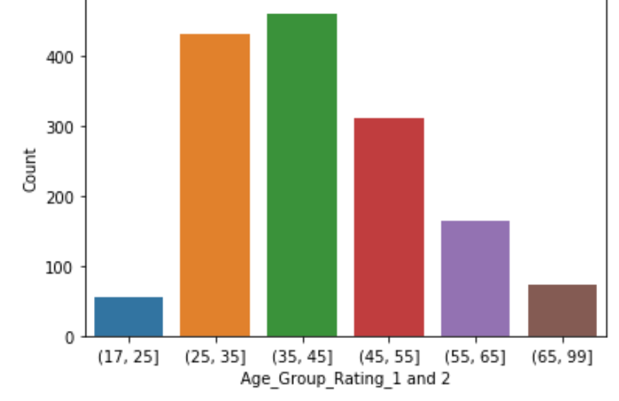
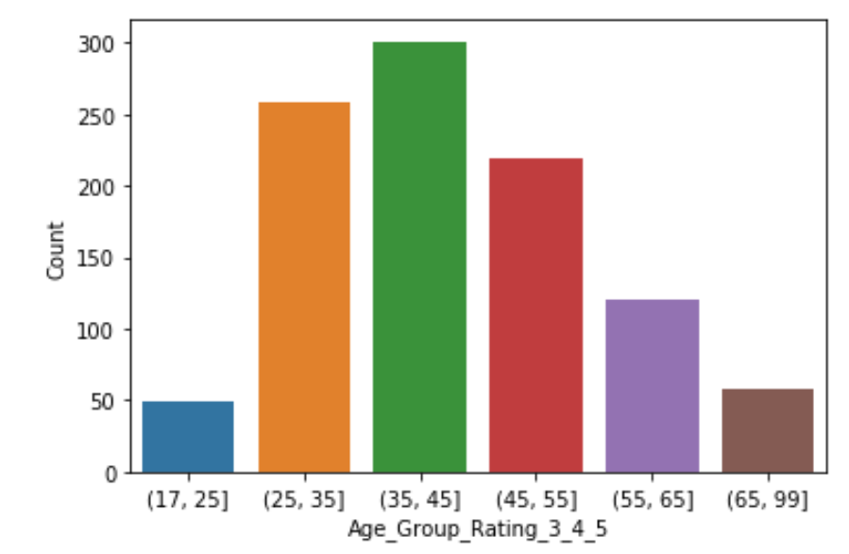
This project aims to help eCommerce clothing Investigate ratings if rating 1-2 information formulate actionable insights for improvements. Rating is fundamental in the online platform.
Department_Name by rating 1-2
Department_Name by rating 3-5
IST652_Scripting Project ecommerce Women’s Clothing
Notes:
'Age','Rating', 'Review_Text','Recommended_IND','Division_Name', 'Department_Name','Class_Name’
Equal data representation 500 each Department name composed of bottoms,dresses, intimate, jackets and top
We will concentrate on the ratings and compare ratings one and two with ratings three through five.
Base on this group, is the demographic change? When applying polarity analysis to the text reviews
, Is the results more positive or negative? What products do you recommend to the customer to focus on or to target products? What model is appropriate for this classification?
compare the demographic for more in-depth analysis.
Product recommendation to for improvement

Slide 4
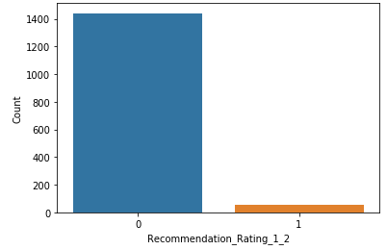
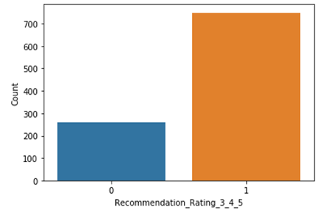
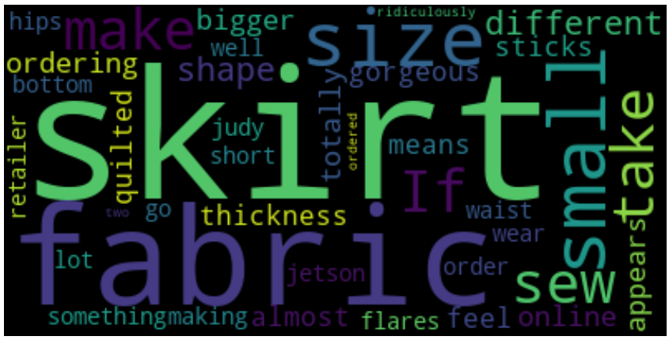
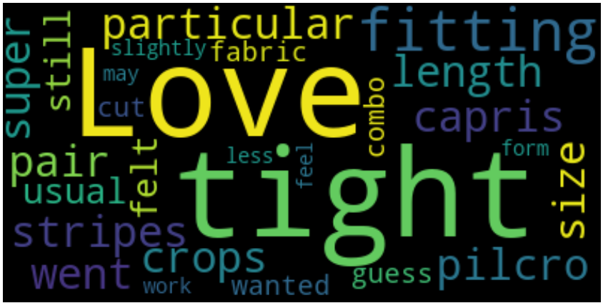

Slide 5
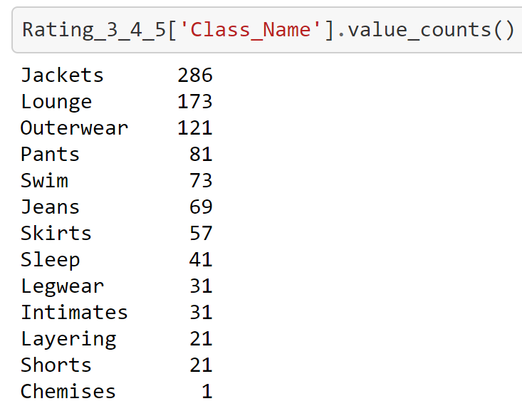
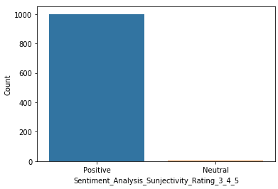
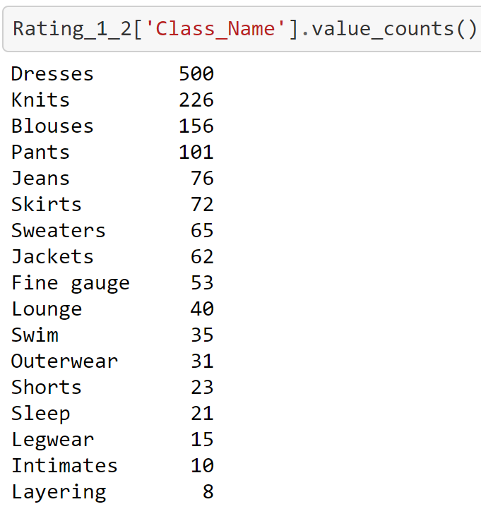
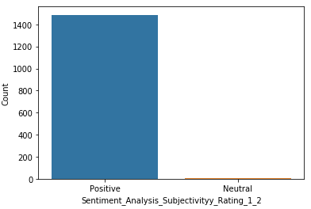
Notes:
After comparing ratings one and two to ratings three through five, the data showed the majority demographics did not change and was still the same age group from ages 25 – 55.
The departments to consider for improvements based on reviews are Dresses and Tops, on tops specifically to knits. These two departments have approximately 1,000 counts of individuals not in ratings three through five.

Slide 6
Model
SVM Accuracy: 0.8090909090909091
cross_val_score cv=5 0.7895522388059703
MNB Accuracy: 0.7757575757575758
cross_val_score cv=5 0.7805970149253731
Bern: 0.7727272727272727
cross_val_score cv=5 0.755223880597015

Slide 7
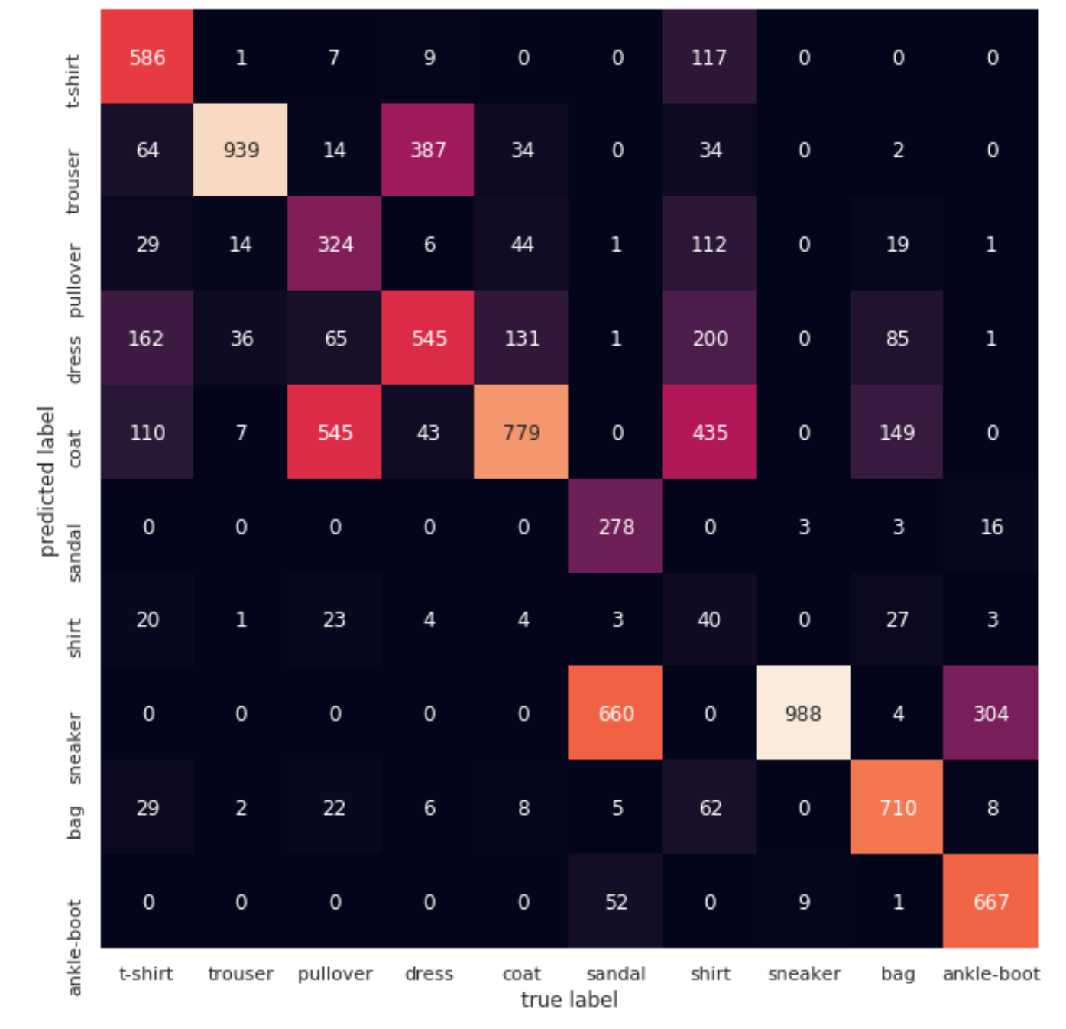
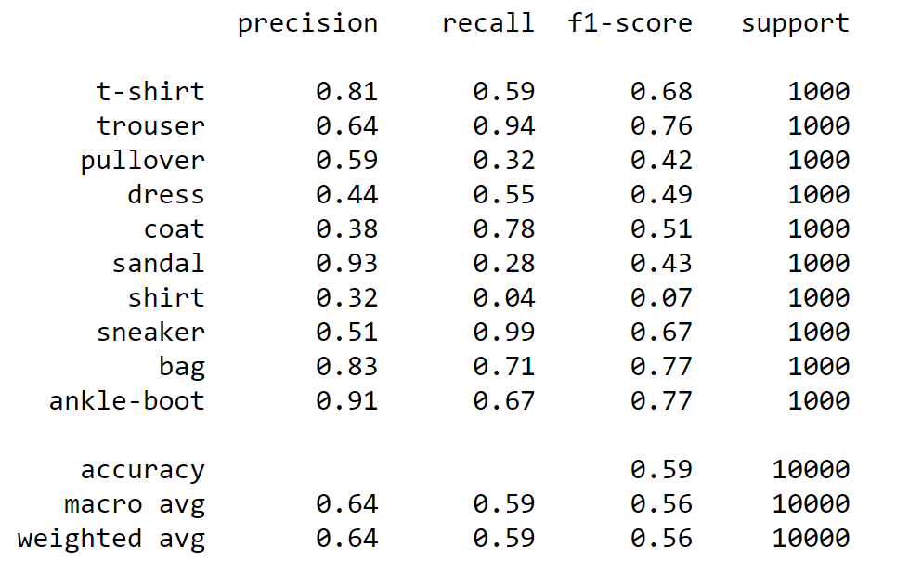
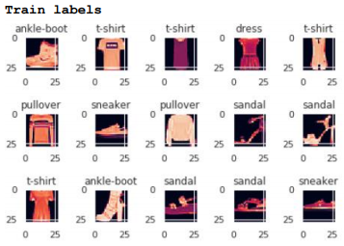
Collection of images created by the National Institute of Standards and Technology (NIST). Each image in the dataset consists of 28 x 28 pixels with 60,000 images for training and 10,000 for testing.
GaussianNB
IST718 Big Data Analytics Big Data PROBLEM MNIST dataset
Notes:
MNIST techniques have been found in the upper 98-99%.
To illustrates which machine learning performed the best between GaussianNB, Decision Tree Classifier, and Neural Network compared to the MNIST techniques
The study illustrates that the neural network implantation significantly better than the GaussianNB with weighted average of 64% and f1 score of 56%. And Decision Tree Classifier with weighted average of 79% and with f1score of 79%. It would be interesting to see if adjustments in the neural network weights, number of layers, and different backward propagation techniques could change the difference between the two implementations. Similarly, changing the parameters for GaussianNB and Decision Tree Classifier. That would be interesting to see if the outcome changes. Compared to the traditional MNIST number classification, the fashion variant is not as accurate. Specifically, the MNIST techniques have been found in the upper 98-99%. However, as stated earlier, more clever techniques could be imposed to draw higher results; this could involve a series of ensemble learners though a simple additional approach could involve appending to the provided dataset. In addition, data could be as simple as a set of images not belonging to any of the target classes. For example, additional images of non fashion images could be used during the train. This would be analogous to extending the one versus rest, taken advantage of within the sklearn framework.

Slide 8
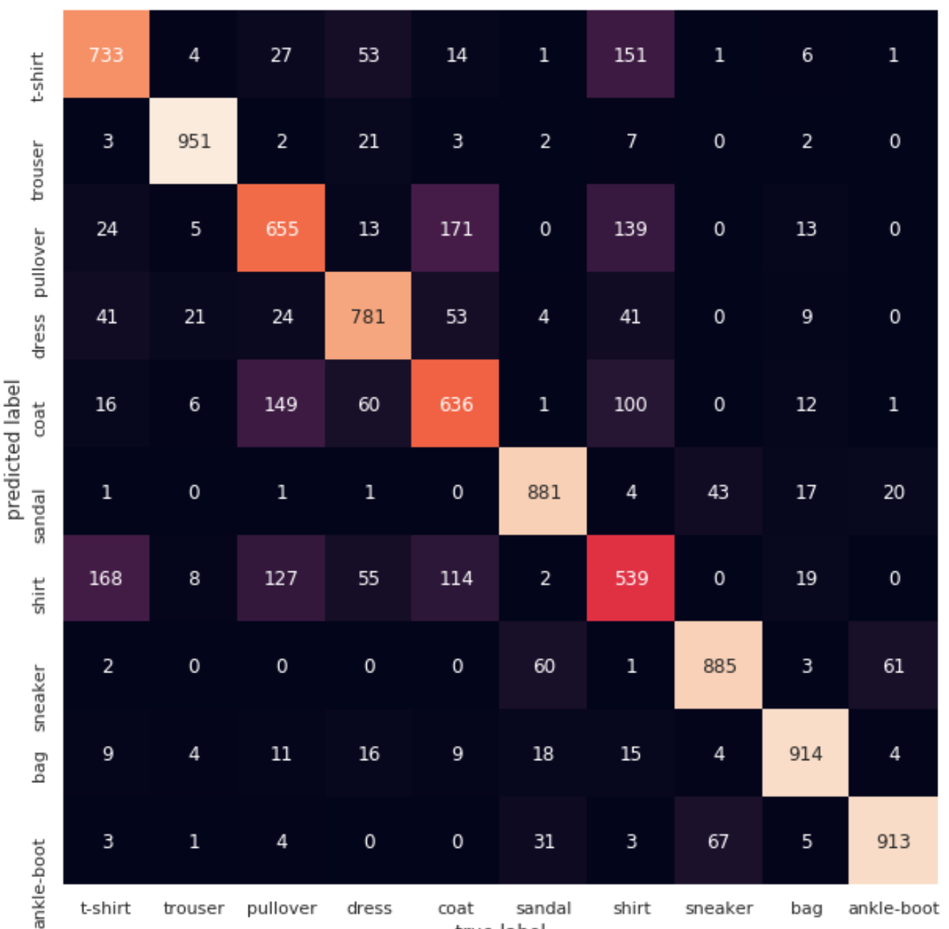
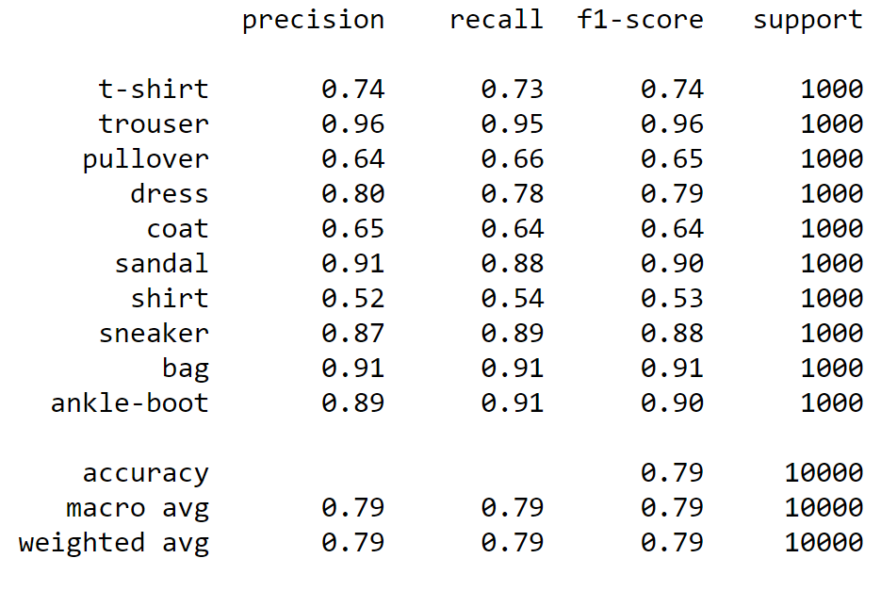
Collection of images created by the National Institute of Standards and Technology (NIST). Each image in the dataset consists of 28 x 28 pixels with 60,000 images for training and 10,000 for testing.
Decision Tree Classifier

Slide 9
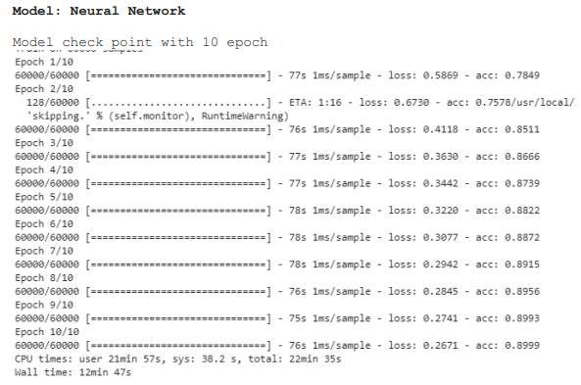
Notes:
Overall this study has succeeded in demonstrating how a multilayer neural network can outperform the GaussianNB and Decision Tree Classifier. However, as stated in the results, it would be interesting to explore the adjustment of parameters for both techniques. Specifically, adjusting the penalty and changing the kernel. It may or may not changes the result. At a higher level, the fashion MNIST dataset is more interesting than its predecessor. More improvements and additional techniques will be needed to achieve the same or close level of accuracy as the numbers example. been found upper 98-99%. On MNIST dataset is a collection of images created by the National Institute of Standards and Technology (NIST). Each image in the dataset consists of 28 x 28 pixels with 60,000 images for training and 10,000 for testing.

Slide 10
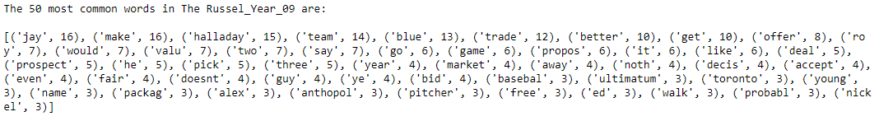
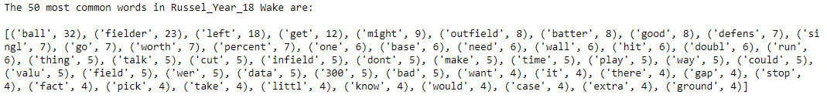
This article that is going to instigate whether the writer has change in his writing approached. Choosing two articles written by Russell Carlton for the year 2009 and the year 2018 in the website Baseball Prospectos was he rely heavily on statistics and the psychological side of the report.
RussY09: 1369 tokens RussY18: 1650 tokens
After removing stop words
RussY09: 805 tokens RussY18: 919 tokens
IST664_NLP Corpus Statistics and Mutual Information

Slide 11
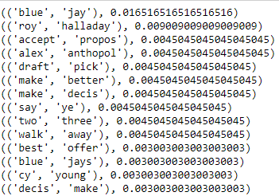
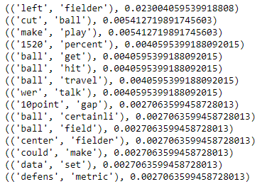
Bi gram forRussel_Year_09
Bi gram forRussel_Year_2018
Pointwise Mutual Information (PMI)
PMI year_2009
(('roy', 'halladay'), 5.250095350126295)
(('blue', 'jay'), 5.138370267567467)
PMI year_2018
(('left', 'fielder'), 4.923406437897166)

Slide 12
Most common words analysis
The 50 words frequency in the year 2009 is all about the team is seems blue jay appears (208) times and Halladay(189) is the main topic about prospect, proposal, and offer. The offer was not fear and someone walkaway.
On the other hand, in 2018, it is a different flavor about the skills; the ball appears 349 times left fielder; these always go together in baseball left fielder scores better than the centerfielder. Talking about the batter, the hit, worth, percentage, and also talks about the defense and all components in the baseball game.
PMI Analysis
In the 2009 article, Russell uses a character-centered approach, focusing on the situation itself and how characters react to the same events.
On the other hand, the 2018 article. Action-based writing. The author keeps the action flowing. There are many descriptive bigrams that either involve adjectives, nouns, or adverbs.

Slide 13
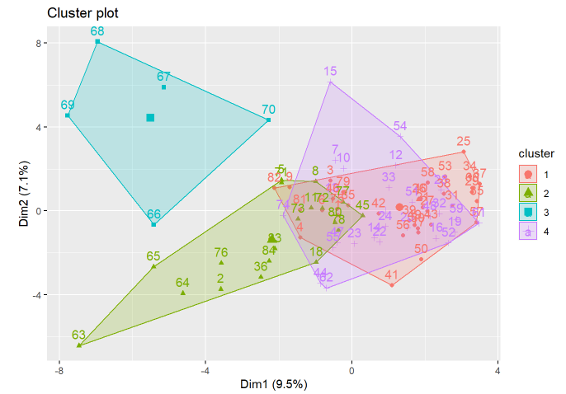
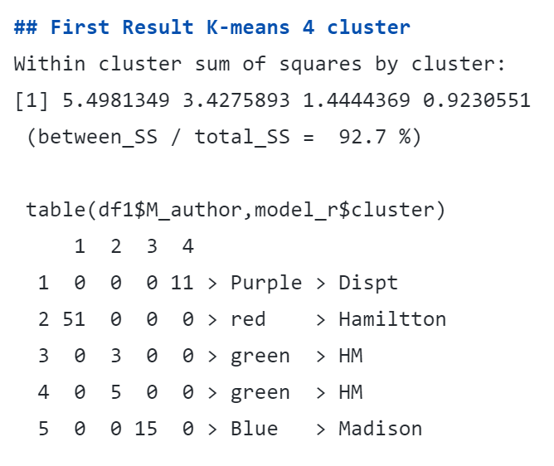
Within cluster sum of squares by cluster: [1] 5.4981349 3.4275893 1.4444369 0.9230551 (between_SS / total_SS = 92.7 %)
table(df1Mauthor,modelrMauthor,modelrcluster) 1 2 3 4 1 0 0 0 11 > Purple Dispt 2 51 0 0 0
> red > Hamiltton 3 0 3 0 0 > green> HM 4 0 5 0 0 > green
> HM 5 0 0 15 0 > Blue > Madison
The United States of America was led by three founding fathers, Alexander Hamilton, James Madison, and John Jay. Collectively, they contributed to 85 papers, known to this day as The Federalist Papers
IST707 Data Analytics Mystery of Federalist Clustering and Prediction

Slide 14
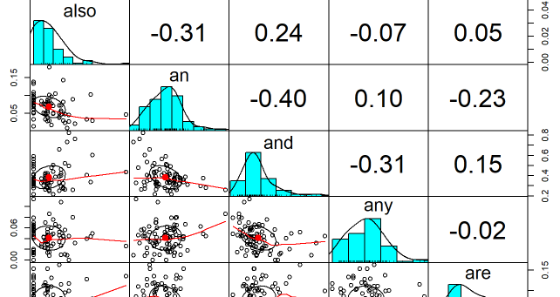
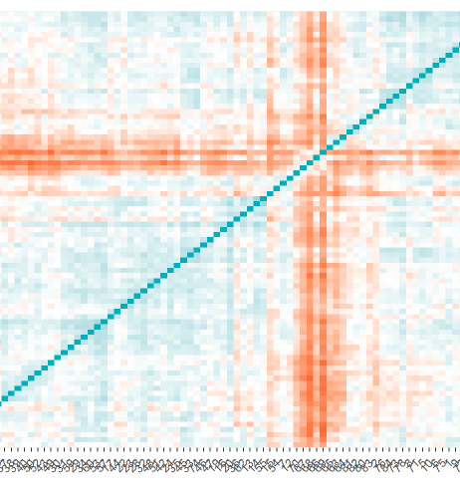
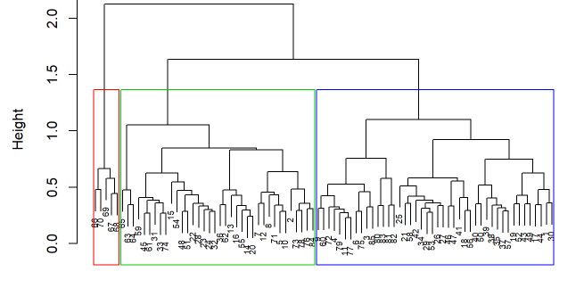
Notes:
Minimum distance in each point 3.267
This is the second ran of 3 clusters, and the result was consistent with the previous ran.
This analysis shows that Alexander Hamilton wrote the majority of the dispute papers.

Slide 15
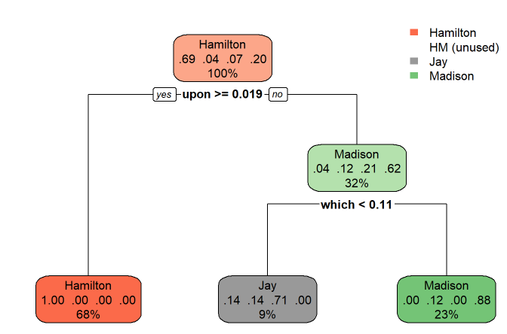
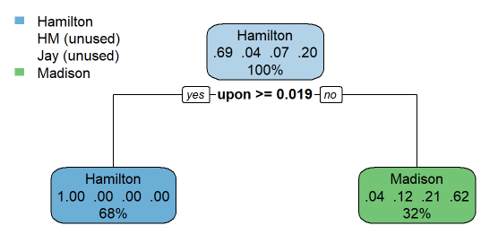

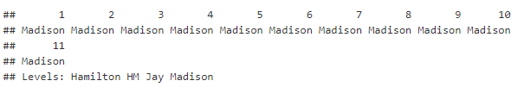
Prediction on Federalist
After tuning
Notes:
From this analysis, it has been found that the disputed authorship appears more closely related to James Madison, then Alexander Hamilton. These results are quite contrary to the previous finding. However, as indicated in this study, implementing proper train and test sets would have provided additional error measures for the corresponding decision tree models. But, due to the relatively small dataset size, further splitting the provided dataset into a train and test set, would have reduced the already small dataset for training a model. This could likely increase the chances of overfitting.
As mentioned in a previous study, obtaining additional works produced by James Madison, to complement the initial dataset, would have produced a richer context to work. The same case for obtaining more writing samples for Alexander Hamilton would be valid. The best steps forward for both studies could likely be an integration of more data, as well as an adjustment to each preprocessing step.
Overall, it seems the results produced by this study are more likely to better predict than the clustering study

Slide 16
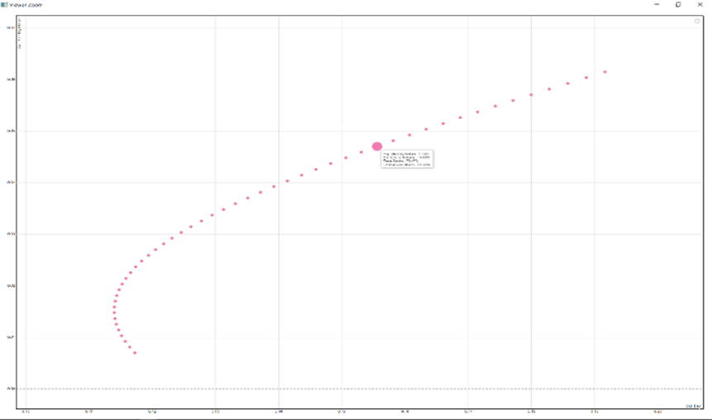

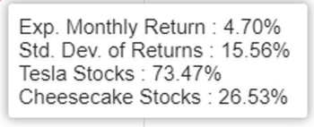
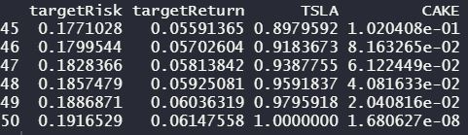
FIN654 Financial Analytics Portfolio Cheesecake and Tesla

Slide 17
Next step
I will be starting my new Job this coming Sept 24th, 2021, as Data Analyst in the Boeing Repair Station Regulatory Quality System Oversight . These would be very interesting, and I will be the main contributor when it comes to data. I will be building different tools and implementing data science as I go.
The Good news when it comes to salary, I’m getting three figures.
My Plan in couple years to lead the organization as Data Scientist

